Slide 1
Fraudulent Merchant classification for an e-commerce client
Presented by
LOKESH MEESALA
Batch 64
ID : 2770

Slide 2
Problem Statement
Our client ‘XYZ’ is an e-commerce company with its operations in several countries.
It has identified that there were some fraudster merchants who scam their customers by delivering counterfeits.
They have approached us seeking for a machine learning model that can help predict the Merchant Fraudulency based on the data provided.

Slide 3
Business Impact
‘XYZ’ doesn’t have any method to effectively addressed the issue.
Customer trust is lost when they are delivered with fake products. It has direct impact on the revenue.
Determining this is also important in budgeting for fraud investigation as they don’t want to waste money by investigating a legitimate merchant.

Slide 4
Attributes
We have 3 files for train and test which contains.
Merchant Information.
Order Information.
Target Information.
We can merge these files using Merchant ID as a Primary Key.
Apart from these we have ip_countries file.

Slide 5
Evaluation Metric
‘XYZ’ told us to use F1 score as the evaluation metric.
It means the business needs us to give equal importance between Recall and Precision.
Recall - Tells us what % of actual positives are correctly identified.(Controls False Negative)
Precision - Tells us what % of predicted positives are correct.(Controls False Positive)
F1 score is more reliable than Accuracy if we have class imbalance.
Notes:
Precision = (True +)/(True +)+(False+) Recall = (True +) / (True +) + (False -) F1 = 2(P*R)/(P+R)

Slide 6
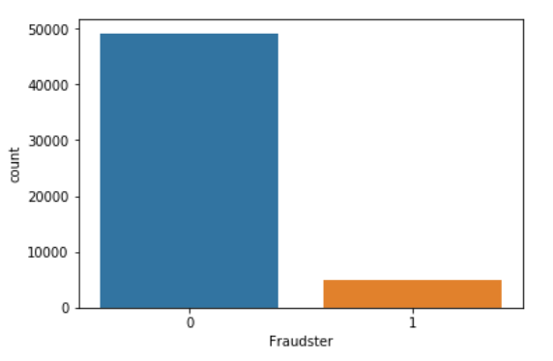
Data Pre-processing
Have observed class imbalance in our data.
We don’t have any missing values.
Removed the columns with high cardinality.
Have performed Standard Scaling on Age and Order Value.
Column | Unique Values
Ecommerce_ID | 100 %
Registered_Device_ID | 94.6 %
Order_ID | 100 %

Slide 7
Feature Extraction
Country from IP_Address.
Customer Type from Customer_ID.
Month of order from Date of Order.
Merchant Type from Merchant Registration Date.
We also derived Continent information from Country.

Slide 8
Feature Extraction
IP_Address
Retrieved country names with IP_Address using ‘rgeolocate’ package in R.
Customer_ID
Derived customer type based on the value_counts on customer ID.
We have Binned customers into ['New Customer','Avg Customer','Old Customer'].

Slide 9
Feature Extraction
Order_data
Extracted month of order from order_data to check if there is any relation between month and fraudulency.
Merchant_Registration_Date
Featured Merchant_type from his registration date.
We have Binned merchants into ['Very_old','Old','Avg','New','Latest'].

Slide 10
Base Model
Built a base model using Logistic Regression with minimum feature set.
Used train_test_split to split the data into train and test.
Got a test F1 score of 0.006276 and train F1 score of 0.006351.
Base model is under fitting in Train and Test.

Slide 11
Weighted Random Forest
Observing the imbalance in target variable built another model using weighted random forest with weights 0.1 to 0 and 0.9 to 1.
Got a test F1 score of 0.602244 and train F1 score of 0.958140.
Model is Over fitting.

Slide 12
Feature Extraction
Using get_dummies on country column exploded our data set.
Extracted Continent information from country.
Did this using ‘pycountry_convert’.
Number of columns before – 144
Number of columns after - 30

Slide 13
Observations on Various Models
Built various models on country feature set and continent feature set.
Tuned n_estimators in KNN.
Tuned n_estimators and learning rate in XGB.
Tuned kernels in SVC.
Used oob score in Random Forest.

Slide 14
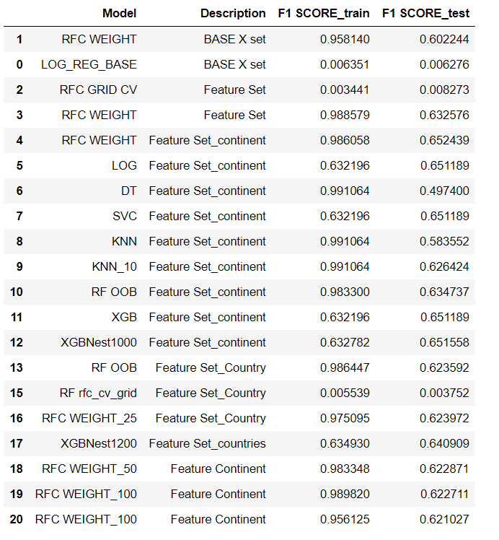
Model_Metrics

Slide 15
Improvements
Using Cross Validation to check over fitting.
Using Grid Search to tune the hyper parameters.
Verify if extracted features have impact on the target.
Keep the model simple and focus on tuning rather than building multiple models.

